Slide 1
B Safe
Your Helpline to Women Safety

Slide 2
App Features
01
Tracks Nearest Hospital and Police Stations
App uses advanced Google places API.
02
Is the given space where you are standing safe?
It gives marks out of 10 to the given place using nearby locations.
03
Alert System
Click this button if you think you are feeling unsafe.
04
Emergency Contact Saver
For those generous people willing to donate organ after leaving for heaven!

Slide 3
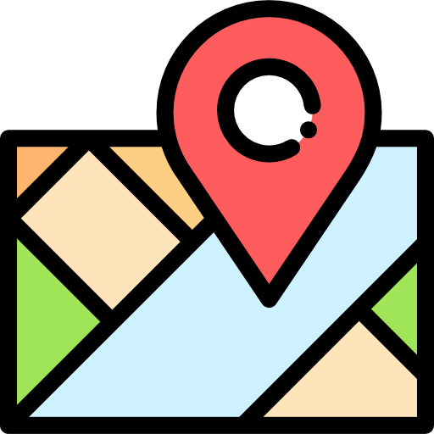
Nearest Hospitals and Police Stations
Our aim is to provide all our user with a detailed and reliable information of all the nearby chemist and hospitals . We further track live location of person and thus provide them a way to reach their location in most optimal time.
All thanks to google places API we were able to achieve this feat !

Slide 4


Emergency Contact Saver
This section is implemented in 3 sections
Donors
01
All people wiling to donate blood to the one in need
Receivers
02
All people who are in urgent need of blood
Blood bank of Hospital
03
Record of all the hospitals with their respective blood banks

Slide 5
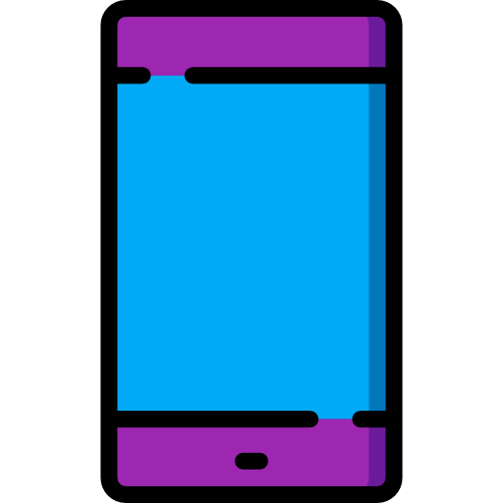

Is Safe Location?
Gives you a score out of 10 to tell you if your location is safe or not….
Directly get a predicted score if the place you are standing is safe or not ?

Slide 6
ORGAN DONATION
They are many people around the globe who want to see the world even after their death. So we have tried to implement the organ donation, thereby generous people can donate their organs .
This application locates the needy people thereby helping them out to locate where it would be available in the blink of an eye!
Your Problem ,
Our Responsibility.

Slide 7
Data
We provide a lot of information on various diets to follow, how much to exercise and notify and thereby improve your IQ and be well prepared for future health related issues.

Slide 8
Opening our App
When you open our app here’s what you experience
Connectivity
Security
Notifications
The App is designed to connect remote locations
In order to ensure privacy and high security we provide various ways to login
We know that you often forget small things in your busy life but don’t worry about that.
Simplicity
Data
At a click of a button you get access to huge areawhich may not be physically possible
We provide our users a lot of information for healthy diet and happy lifestyle

Slide 9
THANK YOU !
TEAM BUGBUSTERS

